Slide 1
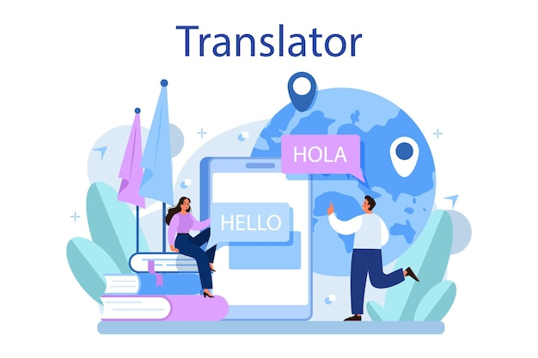
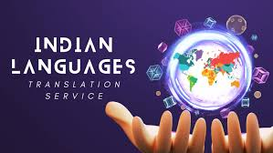
Major Project
Multilingual Signboard Translator Using OCR
Batch No: PWAD21A16

Slide 2

DEPARTMENT OF ARTIFICIAL INTELLIGENCE AND DATA SCIENCE
S.NO NAME ROLL NO.
1 Mohammad Rizwan 160721747007
2 Keshetty Ramya Sri 160721747032
3 Raparthi Bhoomika 160721747058
Guide:
Mrs. Unnati K,
Asst. Prof., Dept. of CSE
Coordinator:
Dr. Shruthi SK,
Assoc. Prof., Dept. of CSE

Slide 3

INTRODUCTION
Significance:
Effective multilingual communication is crucial for social interaction, travel, education, and accessibility in
Today’s globalized world.
Public signboards in local languages are vital sources of information, but often pose challenges for non-native speakers and visually impaired individuals.
Recent advancements in AI, such as Optical Character Recognition (OCR), enable solutions that bridge the gap between written text and human understanding across languages.
To create a Multilingual Signboard Translator for interpreting and translating text from signboard images, live audio input into the user’s preferred language, and converting the translation into speech.
Developed using Python and Flask, offering a web-based interface for easy user interaction.

Slide 4
INTRODUCTION
Technology Integration:
Combining advanced technologies like:
Optical Character Recognition (OCR) for extracting text from signboard images.
Real-time Translation to translate text into user-preferred languages.
Speech Recognition for live audio input.
Speech Synthesis to convert translated text into audio output.
Seamless Communication: Ensures users can understand and interact with signboards regardless of language or sensory limitations, or they can translate using the audio too.
Impact:
Provides travelers with a tool to navigate foreign environments effectively by breaking language barriers.
Enhances accessibility for visually impaired individuals by vocalizing written content.
Demonstrates the potential of AI-driven technologies to solve real-world accessibility challenges.

Slide 5
LITERATURE SURVEY
S.No | Paper Title | Authors | Technique | Learning Methodology | Advantages | Disadvantages | Future Scope | Evaluation Metrics | Accuracy
1 | A Robust Intelligent System for Text-Based Traffic Signs Detection and Recognition in Challenging Weather Conditions (2024) | Khalid, Sara, et al. | Hybrid CNN-SVM for detection and classification | Supervised Learning | Robust in adverse weather | Computationally expensive | Broader traffic sign categories | Accuracy, Precision, Recall | 94.50%
2 | SignboardText: Text Detection and Recognition in In-the-Wild Signboard Images (2024) | Do, Tien, et al. | TextSnake, PANet, FCENet | Supervised Learning | High accuracy in real-world | Struggles with blockages | Multilingual signboards | F1 Score, IoU | 92.70%
3 | Show Me the World in My Language: Establishing the First Baseline for Scene-Text to Scene-Text Translation (2023) | Vaidya, Shreyas, et al. | Transformer-based scene-text translation (SRNet, ControlNet) | Semi-supervised Learning | Efficient cross-language translation | Requires large datasets | Low-resource languages | BLEU, Translation Accuracy | 89.40%

Slide 6
LITERATURE SURVEY
S.No | Paper Title | Authors | Technique | Learning Methodology | Advantages | Disadvantages | Future Scope | Evaluation Metrics | Accuracy
4 | The image of China as a destination for tourist: translation strategies of culture-specific items in the Chinese-English food menus (2023) | Amenador, Kate Benedicta, and Zhiwei Wang | Manual analysis of translation strategies | Qualitative Analysis | Highlights cultural challenges | Limited datasets | Automated cultural context | NA | NA
5 | Traffic Signboard Recognition and Text Translation System using Word Spotting and Machine Learning (2022) | Usha, S. M., D. Mahesh Kumar, and H. B. Mahesh | Word spotting with ML (CNN, K-Means) | Supervised Learning | Reliable recognition and translation | Limited language support | Real-time implementation | Accuracy, Latency | 93.10%

Slide 7
PROBLEM STATEMENT
The research addresses the challenge of understanding signboards in unfamiliar languages by developing a system that extracts text from images or live audio, translates it into the user’s chosen language, and converts it to speech. The primary question is how AI can be utilized to develop a multilingual, accessible text-to-speech system for a diverse range of users. The innovative contribution is a single, real-time solution combining OCR, translation, and speech synthesis for practical use. This study is significant since it bridges language barriers and enhances inclusivity while utilizing reliable AI frameworks to ensure scalability and impact.

Slide 8
OBJECTIVES
Text Recognition: Develop a system using Tesseract OCR to extract text from images of signboards accurately.
Multilingual Translation: Enable real-time translation of extracted text into Indian and global languages using the Google Translate API.
Audio Input: The user can also use the audio input using the speak live button and translate to their preferred language.
Text-to-Speech Conversion: Convert translated text into natural-sounding audio with the Google Text-to-Speech API, ensuring accessibility for visually impaired users.
Image Validation: Implement a mechanism to check the clarity of uploaded images, providing feedback for unclear inputs to improve usability.

Slide 9
ARCHITECTURE
Uploads Image
Image Processing
Select Input Method
User
Live Audio Input
Is the
Image
Clear?
Display an Error message and ask for a clearer image
No
Yes
Capture Audio via Mic
Translates text using Google API (User’s choice)
OCR (Tesseract) extracts text
Speech to Text (Speech Recognizer)
Generates Speech from text (gTTS)
Text Output
The user listens to the Speech

Slide 10
DATA FLOW DIAGRAM (DFD LEVEL-0)
Translation System
User
Google Translate API
Converts to Chosen Language
Uploads Image
OCR Module
Extracts Text
Text Output
Google Text-to-Speech API
Converts Speech to Text
Converts Text to Speech
Speech Recognition
Audio Output
Speak Live

Slide 11
DATA FLOW DIAGRAM (DFD LEVEL-1)
User
Upload Image
& Preprocess
Show Error Message
(Request a clearer image)
Image Unclear
Speak Live
Validate Image Clarity
Image Clear
Process Image Message (Resizing etc.)
Extract Text (OCR)
Speak Recognizer
Text Translation
(Google Translate API)
Text-to-Speech
(Google TTS API)
Listen to the Audio
Text Output

Slide 12
UML DIAGRAM
Use Case Diagram:
Upload Image
Extract Text using OCR
Speak Live
Google Translate API
Speech Recognizer
User
Translate Text
Text Output
Google Text-to-Speech API
Convert to Speech
OCR Module
Listen to the Audio

Slide 13
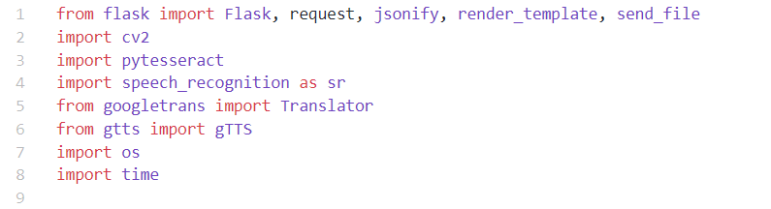
LIBRARIES USED
Flask: A lightweight web framework for building web applications in Python.
cv2 (OpenCV): Used for image processing, including checking image clarity and reading images.
Pytesseract: A Python wrapper for Tesseract OCR, used for extracting text from images.
Speech_recognition: allow applications to transcribe audio input into readable and processable text.
Googletrans: A translation API used to translate extracted text into the user-selected language.
gtts (gTTS): Google Text-to-Speech API used to convert translated text into speech.
Os & Time: Handles file names, paths, and directories.

Slide 14
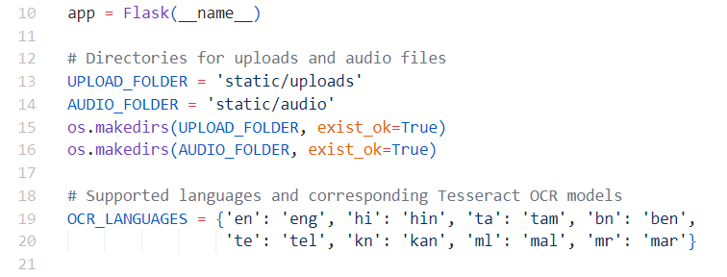
IMPLEMENTATION
1. Initialize Flask App and Setup Directories:
Creates a Flask application instance.
Defines directories to store uploaded images and generated audio files.
os.makedirs(..., exist_ok=True): Ensures the directories exist; if not, they are created.
2. Define Supported OCR Languages:
Defines a dictionary mapping language codes (used in translation) to their corresponding Tesseract OCR models.
Helps in extracting text from different regional languages.

Slide 15
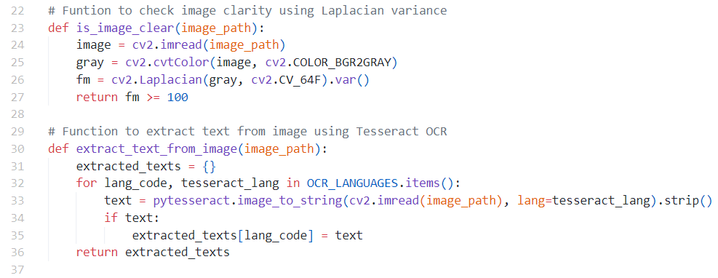
IMPLEMENTATION
3. Check Image Clarity:
Converts the image to grayscale.
Uses the Laplacian variance method to measure sharpness.
If the variance is ≥ 100, the image is clear; otherwise, it is blurry.
4. Extract Text From Image Using OCR:
Iterates over all supported languages.
Extract text for each language using Tesseract OCR.
Stores extracted text in a dictionary ({language_code: text}).
Returns all detected texts from the image.

Slide 16
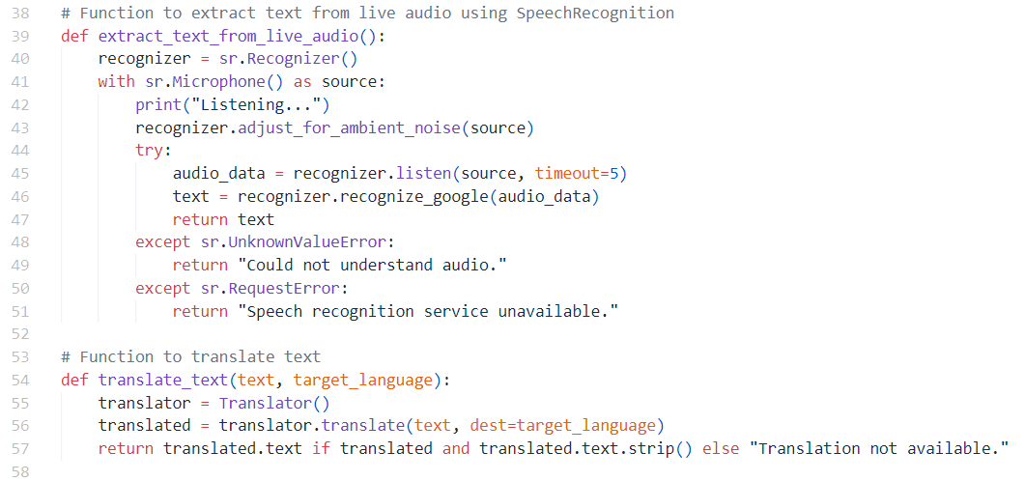
IMPLEMENTATION
5. Extract Text From Live Audio:
The microphone captures the voice when the user speaks.
Speech Recognition is used to extract text from the speech.
Returns the extracted text, or if it fails, it returns “Could not understand audio.”
6. Translate Extracted Text:
Uses Google Translate to translate extracted text into the target language.
If the translation fails or is empty, it returns “Translation not available.”

Slide 17
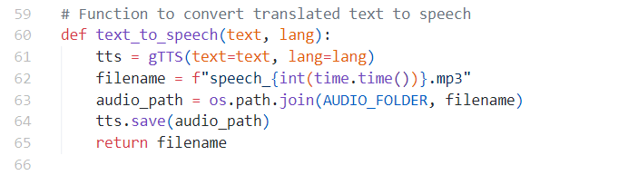
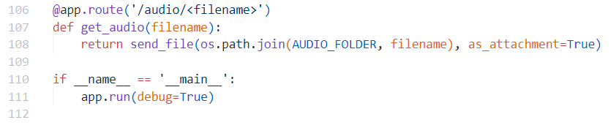
IMPLEMENTATION
7. Convert Translated Text to Speech:
Uses gTTS to convert translated text to speech.
Generates a unique filename using the current timestamp.
Saves the audio file in static/audio/.
8. Route to Serve Audio Files (/audio/<filename>)
Fetches and returns the generated audio file so that it can be played.
9. Run the App:
Run the app.py

Slide 18
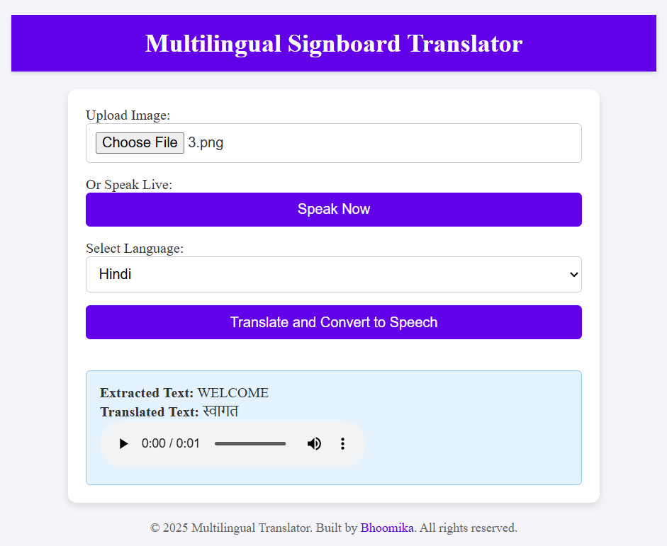
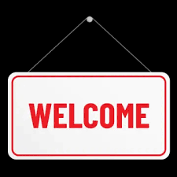
OUTPUT
OUTPUT
INPUT

Slide 19
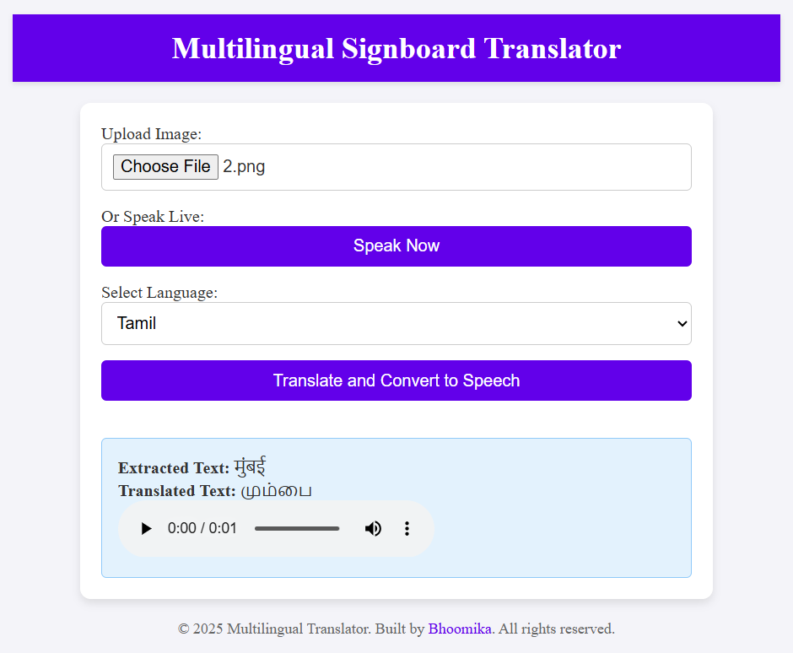
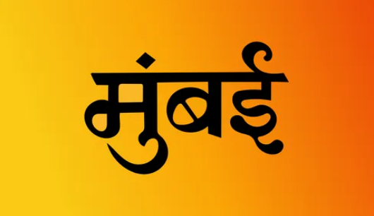
OUTPUT
OUTPUT
INPUT

Slide 20
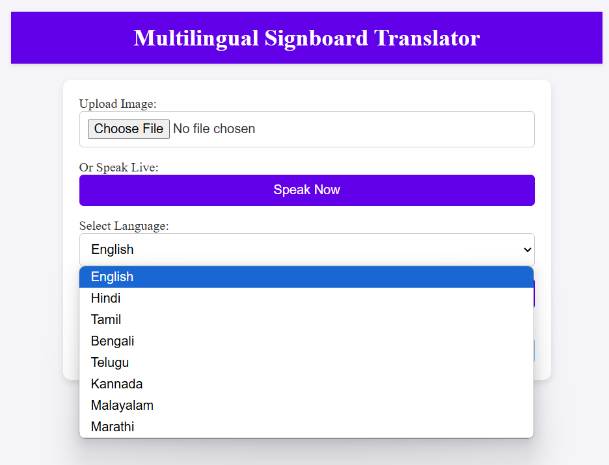
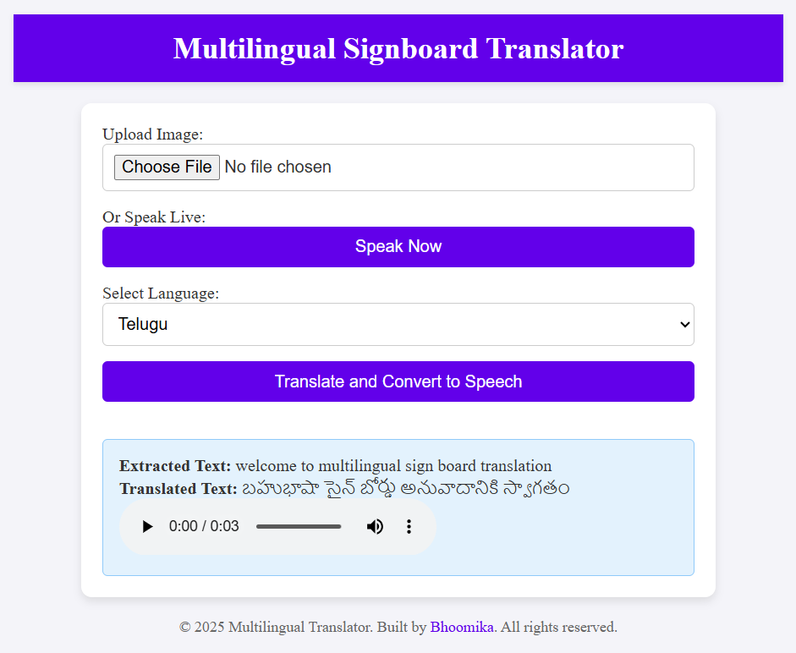
OUTPUT
Web Interface
Audio Input is Translated

Slide 21
CONCLUSION
The Multilingual Signboard Translator will follow a structured development approach, starting with
requirement analysis and system design.
Key components include OCR, Speech recognition, translation, and text-to-speech modules.
Technologies used are Tesseract OCR, Speech recognition for text extraction from images, and live audio
respectively, Google APIs for translation and speech synthesis, and the Python-Flask framework for system
integration and development.
Rigorous testing to handle challenges like blurry images and diverse scripts.
Iterative development with milestones to track progress and refine the system.
Demonstrates AI’s potential in enhancing multilingual communication and accessibility.
Provides an innovative solution to bridge language barriers in real-world scenarios.

Slide 22
FUTURE SCOPE
More Languages & Dialects: Expand support for regional, indigenous, and complex scripts for better accessibility.
Offline Functionality: Implement offline OCR and translation capabilities for areas with limited internet access.
Public Transport & Tourism Integration: Assist travelers and commuters with real-time sign translations.
Gesture Interactions: Hands-free usability with commands and gesture-based controls.
Customizable Experience: Personalize voice styles and accents, and add language learning features.

Slide 23
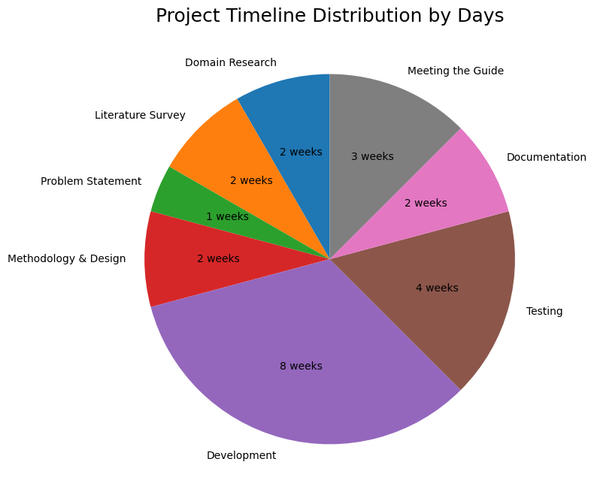
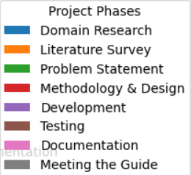
PROJECT TIME LINE

Slide 24


